Slide 1

機器學習於材料資訊的應用
----第五組期末報告
109613004 材料系 余秉叡
109613036 材料系 鄒秉翰

Slide 2
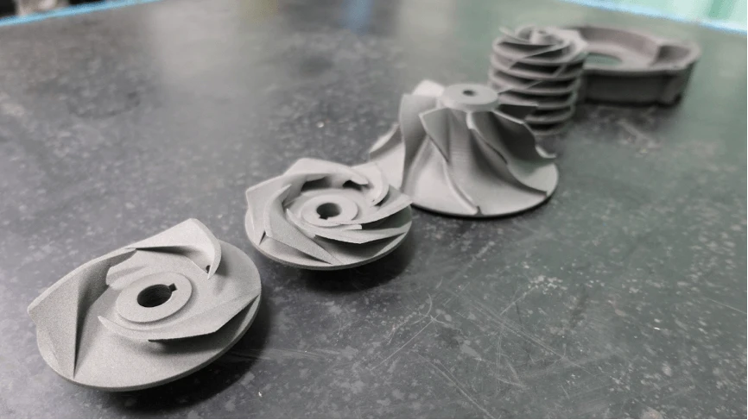
期末報告主題
人工神經網路及自編碼器架構於液壓泵之分析及預測

Slide 3
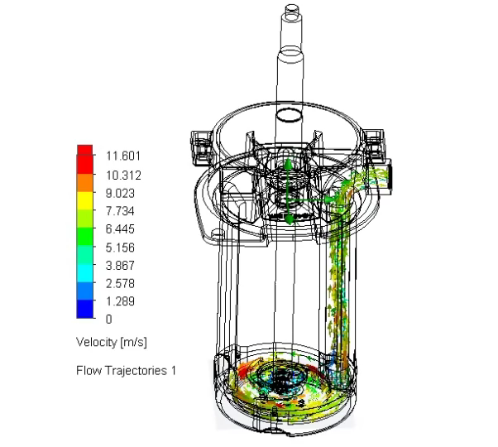
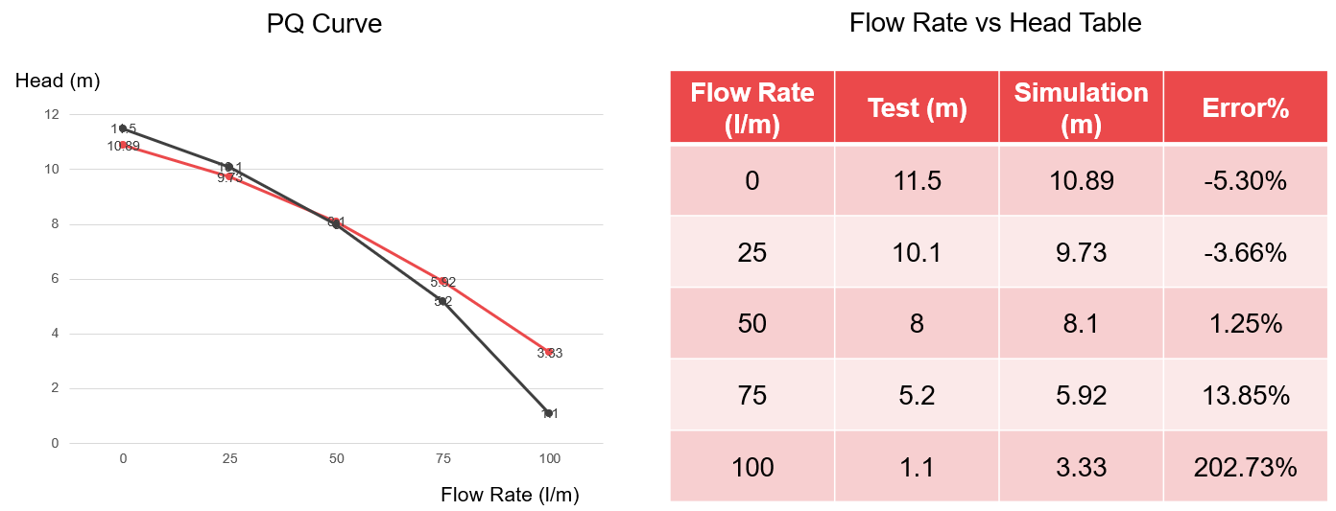
目前現行之模擬方式
透過物理引擎方式建構環境，直接對模型組件進行建模

Slide 4
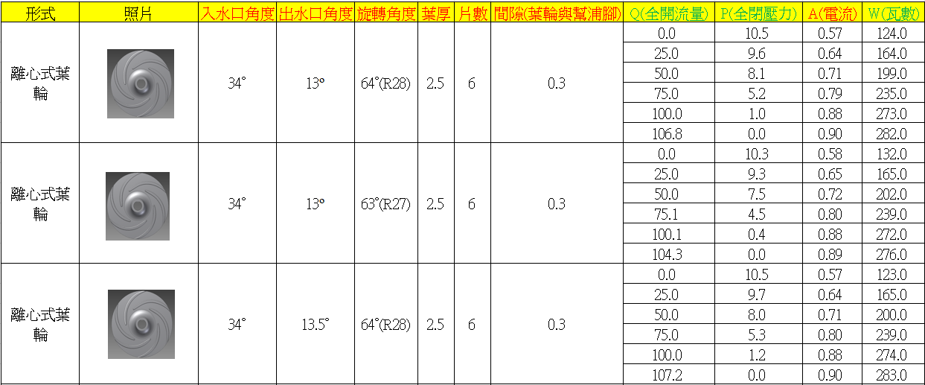
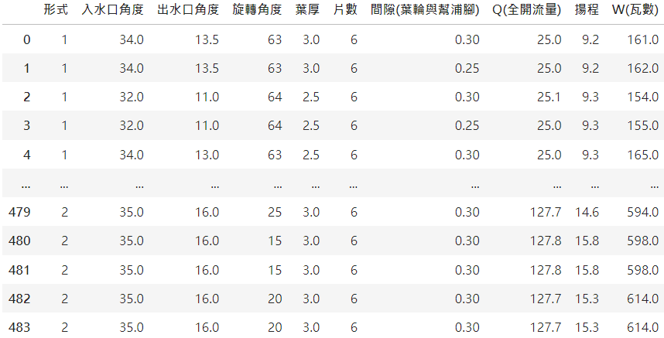
訓練資料來源:
(a)
從業界獲得約600筆實際實驗資料
(b)
實際使用的500筆資料(未標準化)
資料前處理
Table 1. Database of impellers and its parameters. (a) Original data from the company before pre-processing (b) Formal file that can be sent to model (unstandardized).

Slide 5
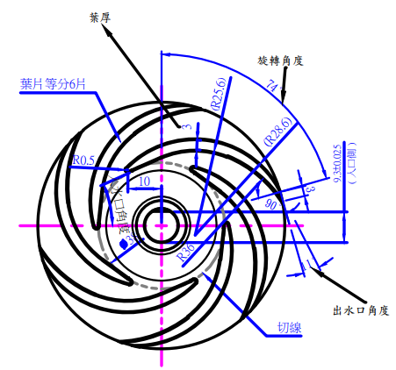
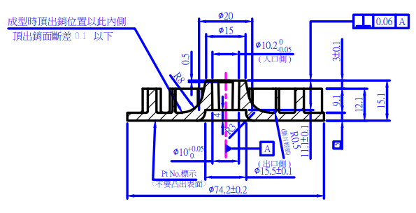
液壓泵參數說明:
(一) 形式: 代表不同的渦輪，1為離心式渦輪，2為混合式渦輪
(二) 入水口角度: 水流進入葉輪的角度
(三) 出水口角度: 水流流出葉輪的角度
(四) 旋轉角度: 基準葉片末端與中心垂直線之夾角
(五) 葉厚: 葉片的厚度，單位為mm
(六) 片數: 葉片數量，數目在3到6之間
(七) 間隙(葉輪與幫浦腳): 葉輪與幫浦腳間的空隙，單位為mm
(八) Q(全開流量): 送入水的流量，單位為公升/分鐘
(九) 揚程: 在沒接任何器具時，水能被加壓傳遞到之距離，單位為m
(十) W(瓦數): 液壓泵運作時之消耗功率，單位為瓦特
(a)
參數
(b)
結果
Figure 1. Design of impeller. (a) Top view and (b) side view

Slide 6
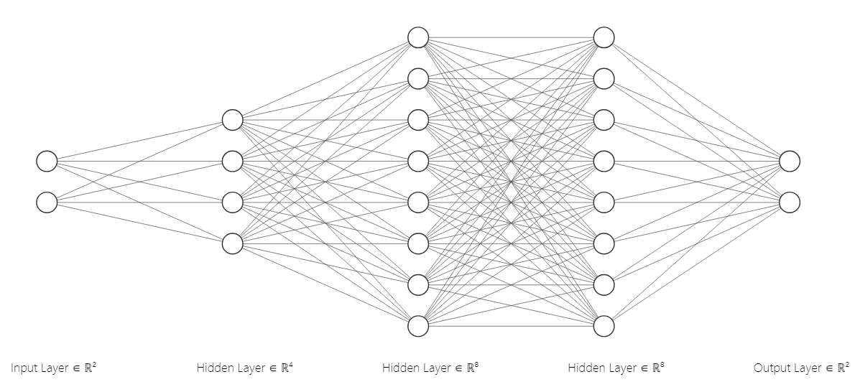
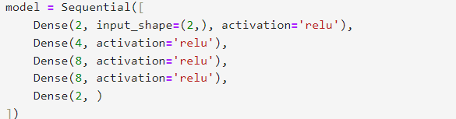
ANN (2,4,8,8,2):
(a)
(b)
Figure 2. Schematic diagrams and a part of code for the structure of neuromorphic computing. (a) and (b) have shown that Model_1 has 2-4-8-8-2 neurons in each layer.

Slide 7
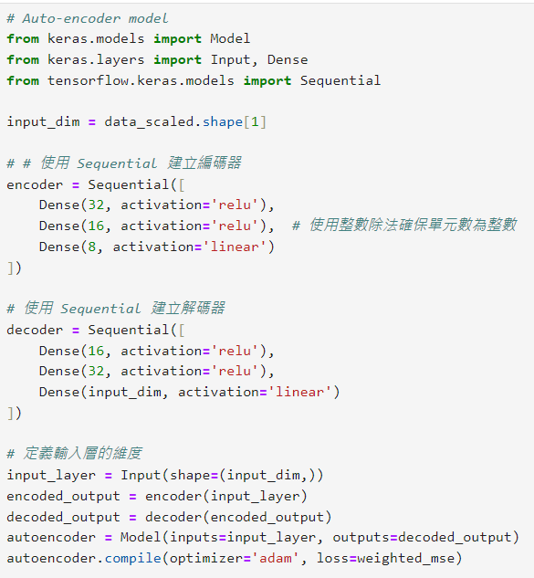
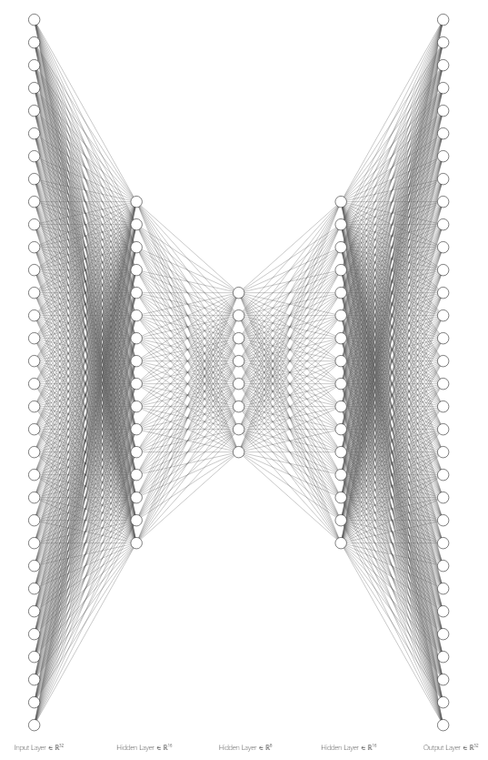
Autoencoder (32,16,8,16,32):
(a)
(b)
Figure 3. Schematic diagrams and a part of code for the structure of neuromorphic computing. (a) and (b) have shown that autoencoder has 32-16-8-16-32 neurons in each layer.

Slide 8
模型數據展示

Slide 9
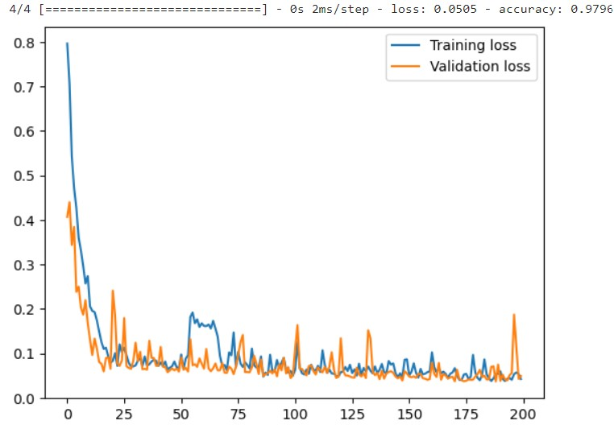

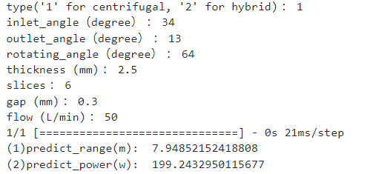
ANN (2,4,8,8,2):
(a)
(b)
(c)
Figure 4. Diagrams for (a) recording the training and validation residual (loss), the average accuracy, and (b) Pearson correlation coefficient. (c) is a single demonstration of ANN model and the real value is 8.1 m and 199 w respectively.

Slide 10
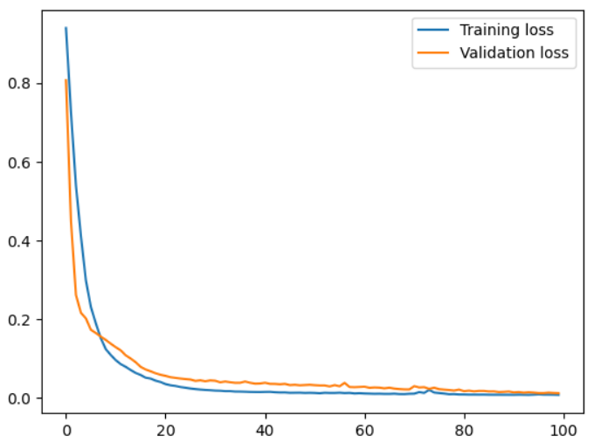

Autoencoder (32,16,8,16,32):
(a)
(b)
Loss is about 0.0124.
Figure 5. Diagrams for (a) recording the training and validation residual (loss) and (b) average reconstruction error.

Slide 11
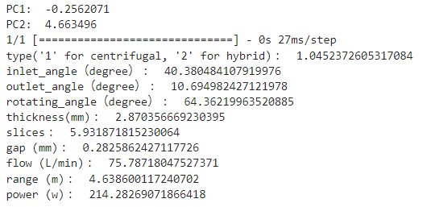


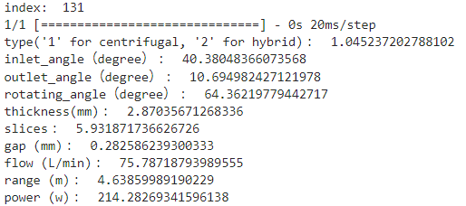
Autoencoder (32,16,8,16,32):
(a)
(c)
(b)
Figure 6. (a) and (b) is a single demonstration of Autoencoder model with respect to 2D latent vector and index. (c) is the more precise prediction value, which is obtained by ANN model stored before.

Slide 12
實驗結果分析

Slide 13
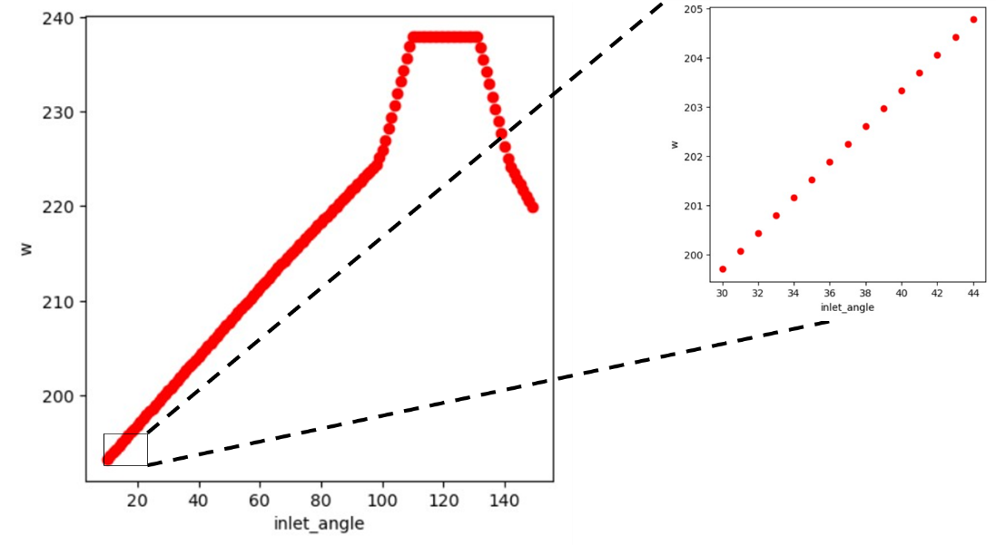
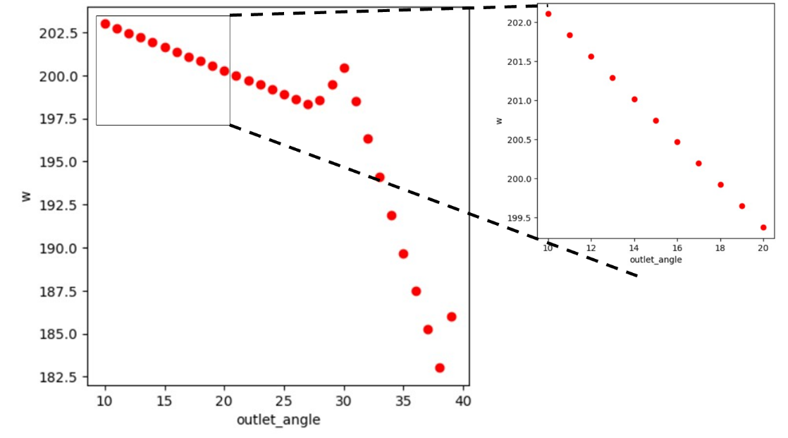
ANN (2,4,8,8,2):
(a)
(b)
Figure 7. Power consumption prediction, displaying the consequences with respect to (a) inlet angle (30-45 degree) and (b) outlet angle (10-20 degree).

Slide 14
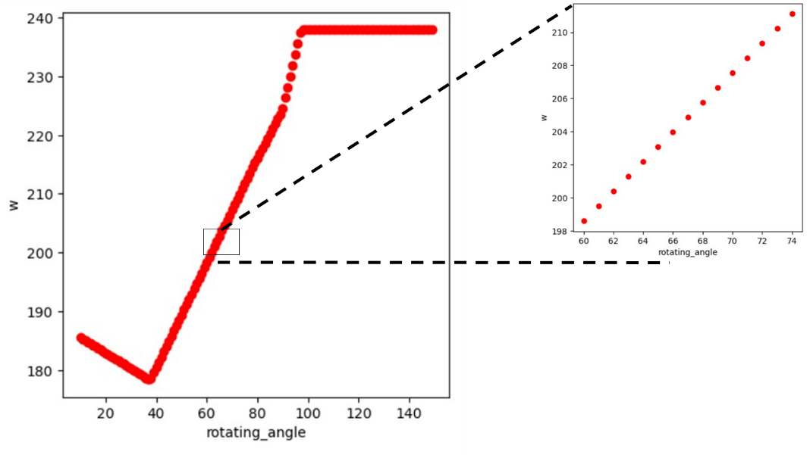
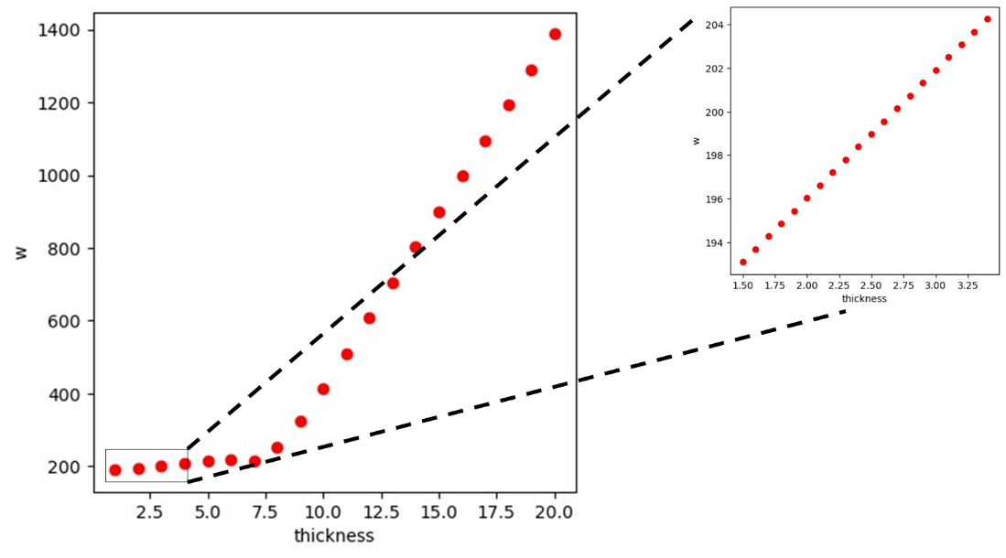
ANN (2,4,8,8,2):
(a)
(b)
Figure 8. Power consumption prediction, displaying the consequences with respect to (a) rotating angle (60-75 degree) and (b) thickness (1.5-3.5 mm).

Slide 15
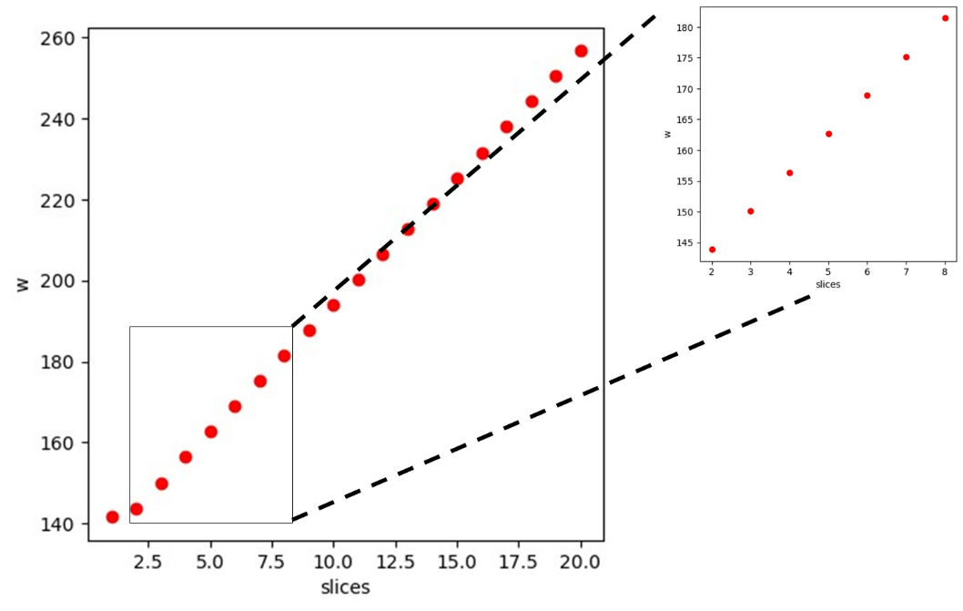
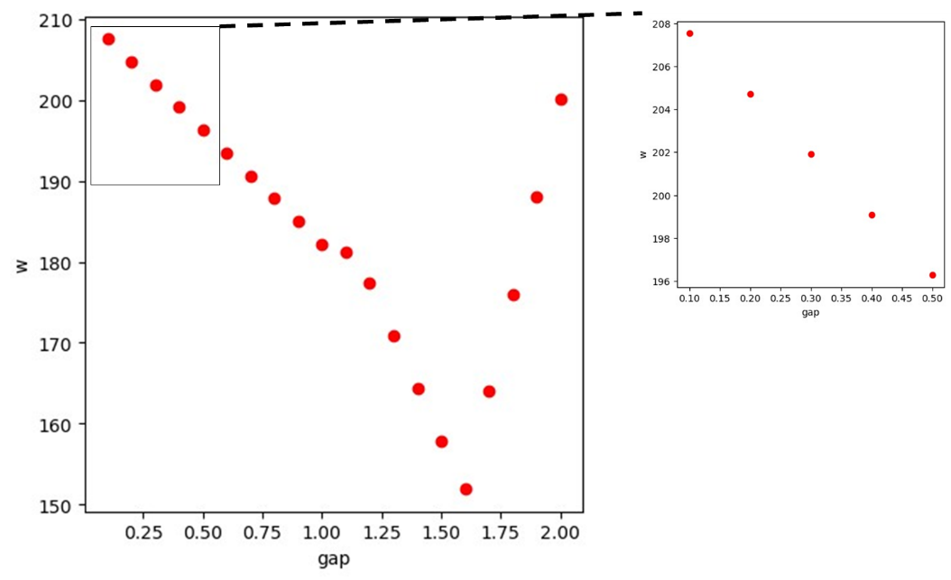
ANN (2,4,8,8,2):
(a)
(b)
Figure 9. Power consumption prediction, displaying the consequences with respect to (a) slices (2-8)and (b) gap (0.1-0.5 mm).

Slide 16
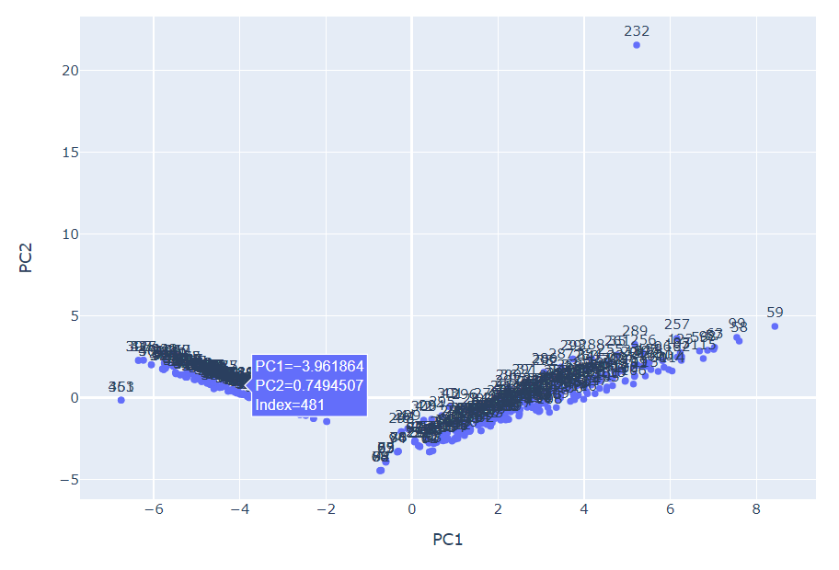
Autoencoder (32,16,8,16,32):
Figure 10. Displaying the consequences of design recommendation with index.

Slide 17
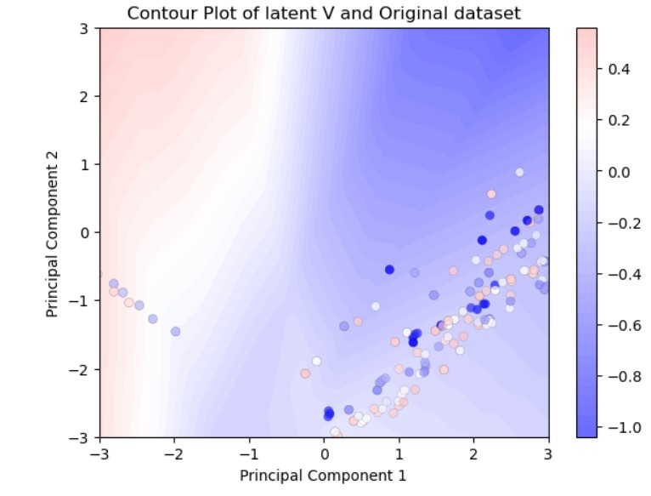
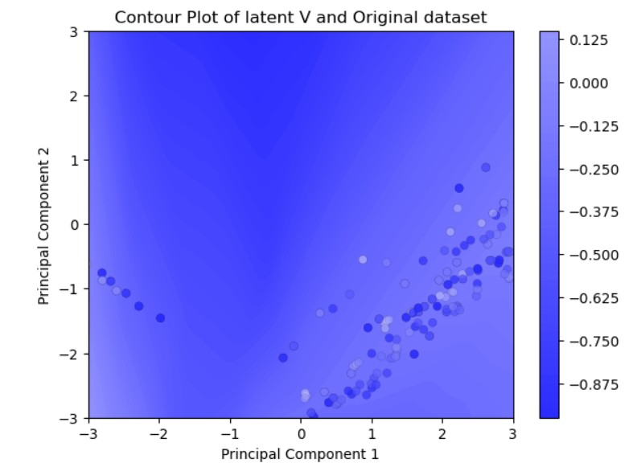
Autoencoder (32,16,8,16,32):
(a)
(b)
Figure 11. Displaying the consequences of design recommendation with respect to (a) range and (b) power consumption.

Slide 18
結論

Slide 19
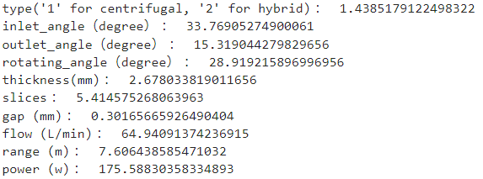

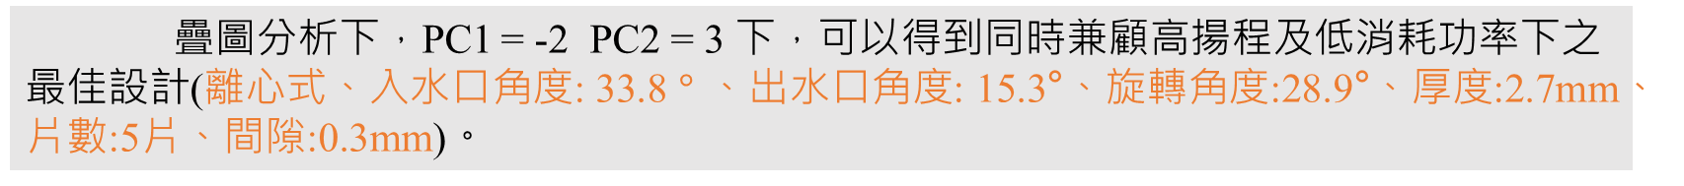
ANN (2,4,8,8,2):
在一般常用中間值配置下，入水口角度越大、出水口角度越小、旋轉角度越小、厚度越薄、片數越少、間隙越大，所需消耗功率越低。
Autoencoder (32,16,8,16,32):
疊圖分析下，PC1 = -2 PC2 = 3 下，可以得到同時兼顧高揚程及低消耗功率下之最佳設計(離心式、入水口角度: 33.8$°$、出水口角度: 15.3°、旋轉角度:28.9°、厚度:2.7mm、片數:5片、間隙:0.3mm)。

Slide 20
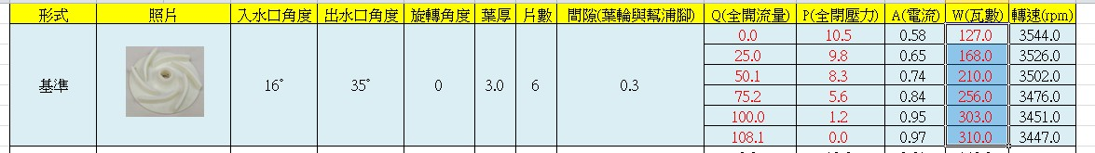
效能比較:
最佳葉輪(try and error):
fluid rate
range
power
以粗略的外插法估計，在流量65 L/min下， Range: 6.68 (m) Power: 237.6 (w)
最佳葉輪(machine learning):
Autoencoder及ANN結合，在流量65 L/min下， Range: 8.62 (m) Power: 184.9 (w)

Slide 21
THANK YOU

